Slide 1
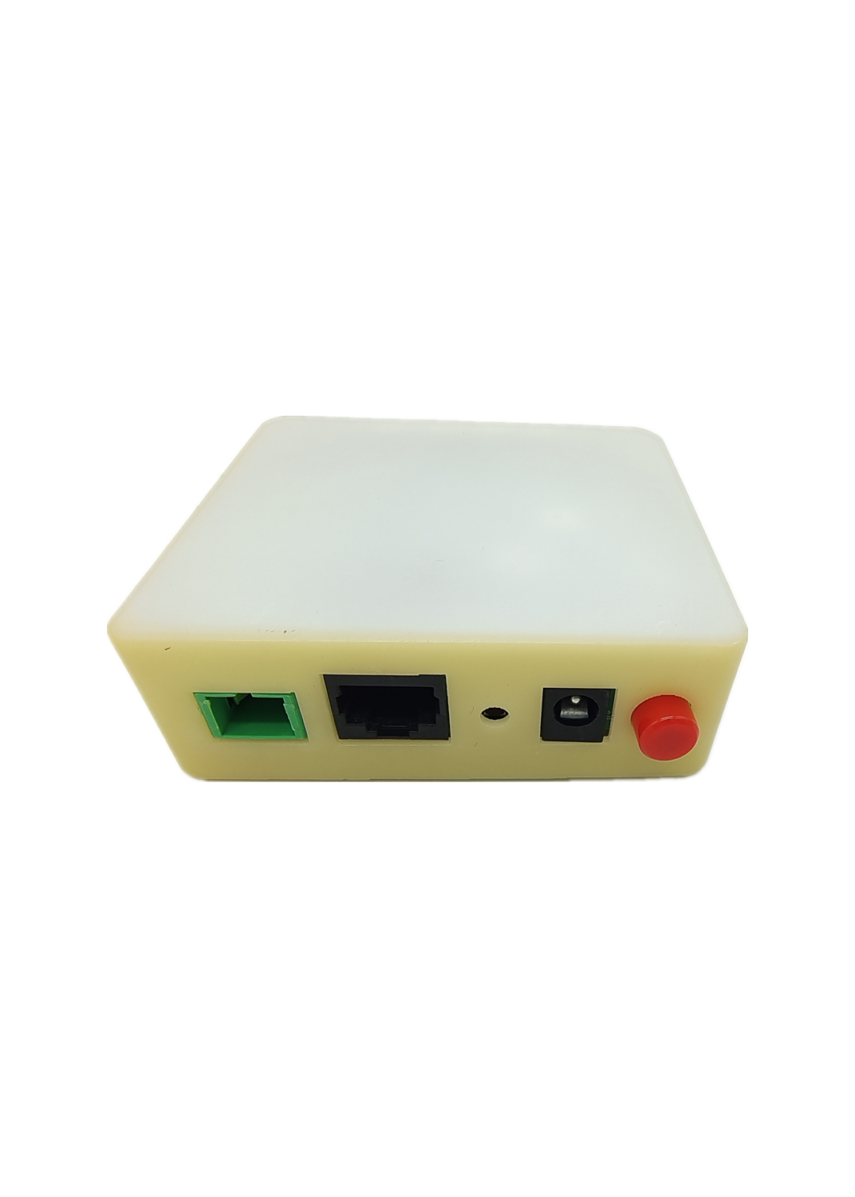








GPR2010/GPR2010-GW
1*XPON+1*GE
Key Features
★XPON EPON/GPON Auto-Negotiation
★Powerful Firewall
★Easy Installation
★Easy Using
★Small&Low Cost
Product Profiles
GPR2010 is a single gigabit port ONT with a bottom mounted fiber structure. It adopts an optimized bottom mounted fiber structure, effectively improving transmission performance and reducing fiber loss. At the same time, the ONT also supports single gigabit port access, which can meet various access needs. The exquisite craftsmanship and selected materials make this ONT look more beautiful and durable, providing stable communication services for home networks. This ONT is simple and easy to use, making it an ideal choice for home broadband networks.
This ONT has high reliability and can be applied in a wide range of temperature environments; And it has a powerful firewall function, which is easy to manage and maintain. It can provide QoS guarantee for different services. This ONT complies with a series of international technical standards such as IEEE802.3ah and ITU-T G.984.
Product Application
12V DC
WiFi Equipment
Internet
Cable Video
OLT
WIFI Router
Computer
ODN
GPR2010/GPR2010-GW

Slide 2
Hardware Parameters
Interface Performances
功能数据
Product Size | 81mm×73.5mm×26.8mm(L*W*H)
Net Weight | About 71g(Without Packing)
Working Environment | Working Temperature: 0 to + 40°C Working Humidity: 10% to 90% (non-condensing)
Storage Environment | Storage Temperature: -40 to + 70°C Storage Humidity: 5% to 95% (non-condensing)
Power Supply | DC 12V/0.5A
Power Consumption | ≤4W
Interfaces | 1*PON,1*GE
Buttons | Reset,ON/OFF
LED Indicators | Power,PON,LOS,LAN
PON | 1*PON Port(EPON PX20+ and GPON Class B+) Single-mode Optical Fiber，SC/APC Transmission Power：0～+4dBm Receiver Sensitivity： -27dBm Overload: -3dBm(EPON) or -8dBm(GPON) Distance：20KM Wavelength: TX 1310nm, RX1490nm Rate：Upstream:1.25Gbps, Downstream:2.5Gbps
LAN | 1*GE,10/100/1000 1000BASE-T Auto-Negotiation

Slide 3
Software Parameters
Software Parameters
功能数据
Basic | Support MPCP discover&register Support authentication Mac/Loid/Mac+Loid Support Triple Churning Support DBA bandwidth Support auto-detecting, auto-configuration, and auto firmware upgrade Support SN/Psw/Loid/Loid+Psw authentication
Alarm | Support Dying Gasp Support Port Loop Detect Support Eth Port Los
LAN | Support Port rate limiting Support Loop detection Support Storm cONTrol
VLAN | Support VLAN tag mode Support VLAN transparent mode Support VLAN trunk mode(max 8 vlans)
Multicast | Support IGMPv1/v2/Snooping Max Multicast vlan 8 Max Multicast Group 64
QOS | Support 4 queues Support 802.1P
L3 | Support IPv4/IPv6 Support DHCP/PPPOE/Static IP Support Static route Support NAT
Management | Support CTC OAM 2.0 and 2.1 Support ITUT984.x OMCI Support WEB Support TELNET Support CLI Support TR069 ACS management
XPON Mode | Dual mode,Auto-access to EPON/GPON OLT
Uplink Mode | Bridging and Routing Mode
Abnormal protection | Detecting Rogue ONT, Hardware Dying Gasp
Firewall | DDOS, Filtering Based on ACL/MAC/URL
Packing Lists
XPON *1 Power Adapter *1 Ethernet Cable *1 Quick Installation Guide *1
Ordering Information
GPR2010 | SFU
GPR2010-GW | HGU

Slide 4

功能数据
Empowering The Internet Of Things
Revision Information
Version | Description | Date | Revised By
V1.0 | Initial | 2023.12.31 | Raymond
Contact Us
WuHan IDXLINK Technology Co.,Ltd.
www.idxlink.com.cn
sales@idxlink.com.cn
supports@idxlink.com.cn
Notice
IDXLINK will thoroughly inspect the printing and drawings for errors, but IDXLINK is not responsible for any possible omissions. The appearance, specifications, parameters, prices, and supply status of the products listed in this document are subject to change at any time and are not subject to change with Another notice.

